Slide 1
Functions

Slide 2
Functions
is a set of statements that take inputs, do some specific computation and produces output.
to put some commonly or repeatedly done task together and make a function so that instead of writing the same code again and again for different inputs.
General form
return_type function_name([ arg1_type arg1_name, ... ])
{
code
}

Slide 3
#include <stdio.h>
// An example function that takes two parameters 'x' and 'y'
// as input and returns max of two input numbers
//Called function
int max(int x, int y) //Formal parameters
{
if (x > y)
return x;
else
return y;
}
// main function that doesn't receive any parameter and
// returns integer.
int main(void) //Calling function or Caller
{
int a = 10, b = 20;
// Calling above function to find max of 'a' and 'b'
int m = max(a, b); //Actual parameters
printf("m is %d", m);
return 0;
}

Slide 4
Why do we need functions?
Functions help us in reducing code redundancy. Rather than writing the same code, again and again, we create a function and call it everywhere.
Functions make code modular. Consider a big file having many lines of codes. It becomes really simple to read and use the code if the code is divided into functions.
Functions provide abstraction. For example, we can use library functions without worrying about their internal working.

Slide 5


Function Declaration
A function declaration tells the compiler about the number of parameters function takes, data-types of parameters and return type of function.
Putting parameter names in function declaration is optional in the function declaration, but it is necessary to put them in the definition.
Eg:

Slide 6
It is always recommended to declare a function before it is used
In C, we can do both declaration and definition at the same place
C also allows to declare and define functions separately, this is especially needed in case of library functions. The library functions are declared in header files and defined in library files.

Slide 7
Parameter Passing to functions
The parameters passed to function are called actual parameters.
The parameters received by function are called formal parameters.
Pass by Value: In this parameter passing method, values of actual parameters are copied to function’s formal parameters and the two types of parameters are stored in different memory locations. So any changes made inside functions are not reflected in actual parameters of caller.
Pass by Reference Both actual and formal parameters refer to same locations, so any changes made inside the function are actually reflected in actual parameters of caller.

Slide 8
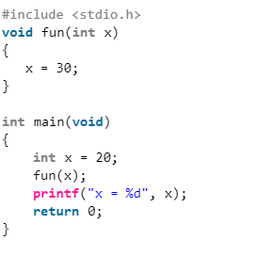
Pass by value (Call by value)
Output
x=20
X=

Slide 9
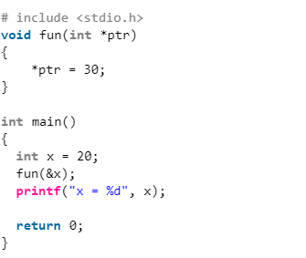
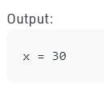
Pass by reference (Call by reference)

Slide 10
consider the above program. The function fun() expects a pointer ptr to an integer (or an address of an integer). It modifies the value at the address ptr. The dereference operator * is used to access the value at an address.
In the statement ‘*ptr = 30’, value at address ptr is changed to 30. The address operator & is used to get the address of a variable of any data type. In the function call statement ‘fun(&x)’, the address of x is passed so that x can be modified using its address

Slide 11
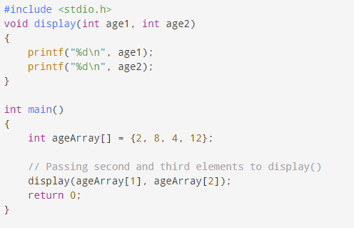
Passing an array
Passing individual array elements

Slide 12
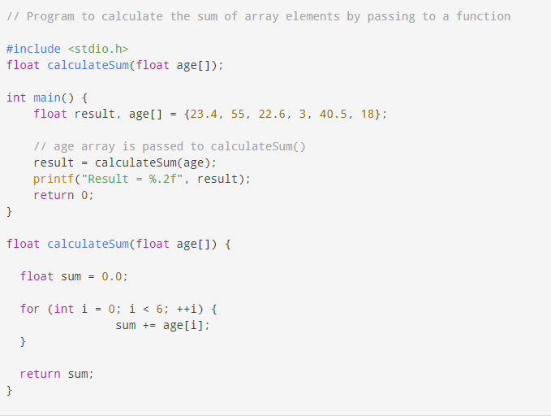
Passing arrays to functions

Slide 13
Way-1
Formal parameters as a pointer:
void myFunction(int *param)
{
}
Way-2
Formal parameters as a sized array:
void myFunction(int param[10])
{
}
Way-3
Formal parameters as an unsized array:
void myFunction(int param[10])
{
}

Slide 14
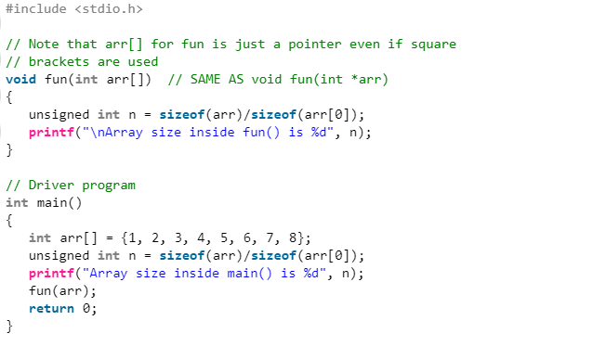
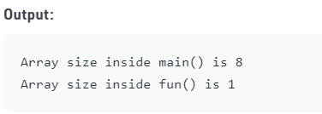

Slide 15
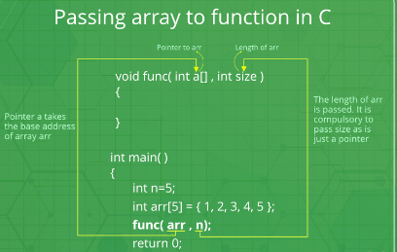

Slide 16
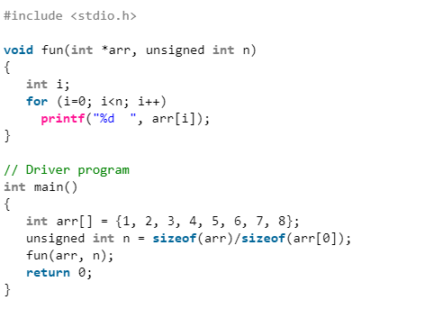

Slide 17
